Slide 1
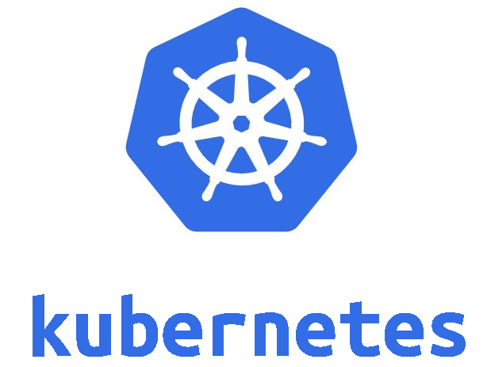
KUBERNETES & HELM CHARTS

Slide 2
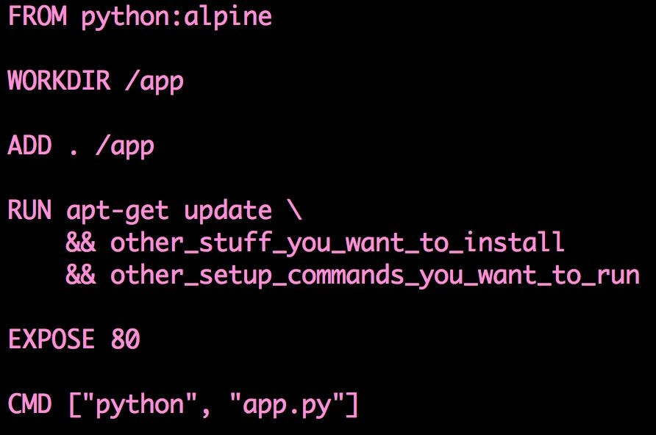
CONTAINERS
Let’s put an app inside the baby computer!
SERVER
CONTAINER
Alpine 3.6.2
Python 3.7
Setup
APP
Googling keywords: Dockerizing applications, container vs. virtual machine

Slide 3


Where should I live?
How do I talk to other containers? How do I talk to the world?
What happens if I get sick?
SERVER
SERVER
SERVER

Slide 4
POD
11.10.20.2
11.10.20.1
Great Paper: Large Scale Cluster Management at Google with Borg

Slide 5
DEPLOYMENTS

Slide 6
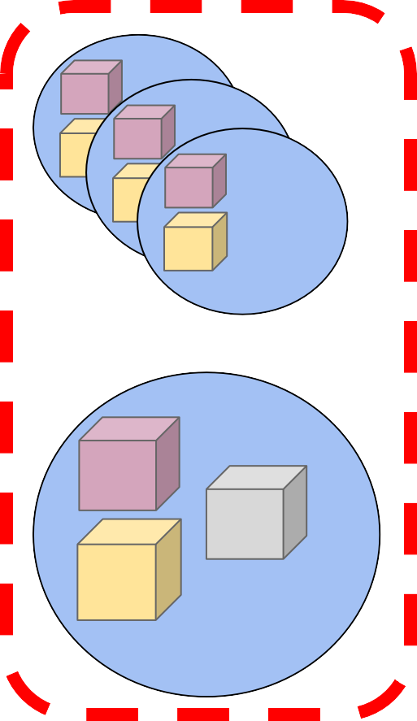
service1.default.svc.cluster.local
service2.default.svc.cluster.loca l
SERVICES

Slide 7

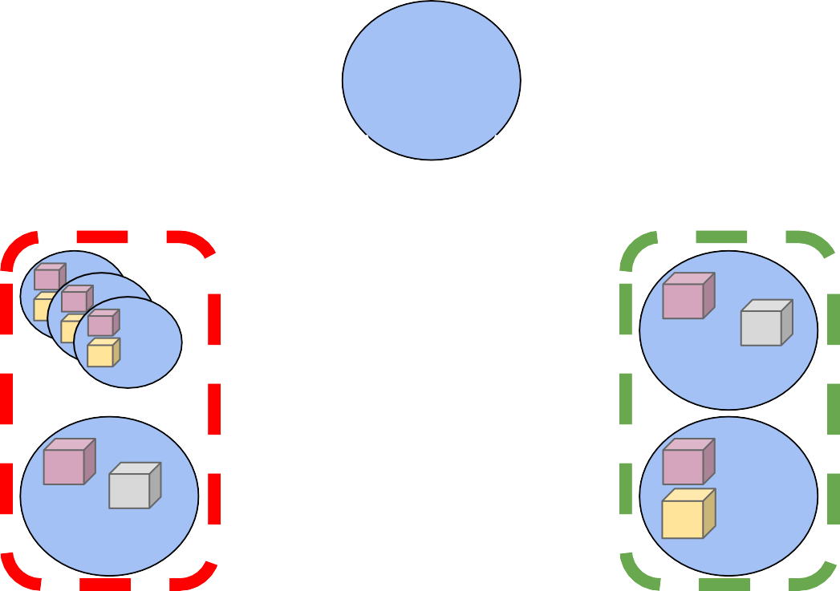
INGRESS
THE INTERNET
INGRESS
/foo
/bar
/baz
Service A
Service B
Service C
10

Slide 8
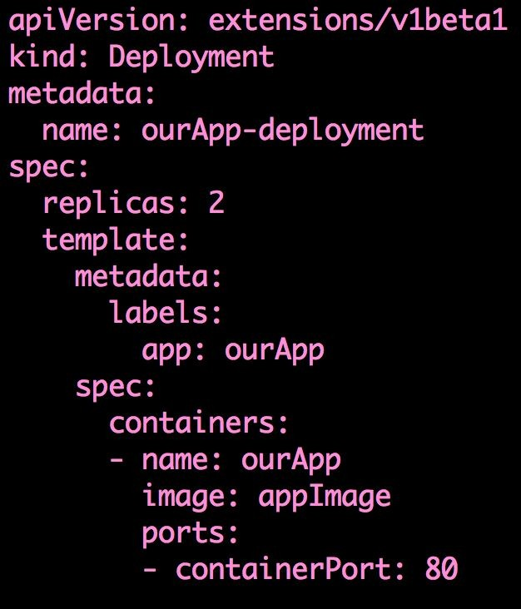
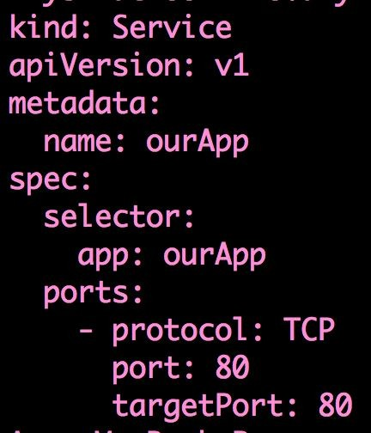
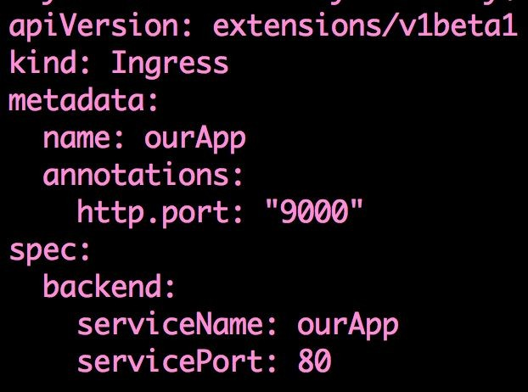
Deployment.yaml
Service.yaml
Ingress.yaml
Great Paper: Large Scale Cluster Management at Google with Borg

Slide 9
$ | kubectl | create | -f | deployment.yaml
$ | kubectl | create | -f | service.yaml
$ | kubectl | create | -f | ingress.yaml

Slide 10
How do we manage/version control a deployment using Helm Charts

Slide 11
name: ourApp
version: 1.0.0
description: Let’s make a Helm Chart maintainers:
name: SRE Charts Demo
email: test@test.com

Slide 12
amy-demo
$ helm install SRE-Charts
$ helm list
NAME UPDATED CHART
Random Fri Sept 29 ourApp-1.0.0
└─ Chart.yaml
└─ manifests
└─ deployment.yaml
└─ service.yaml
└─ ingress.yaml

